Slide 1
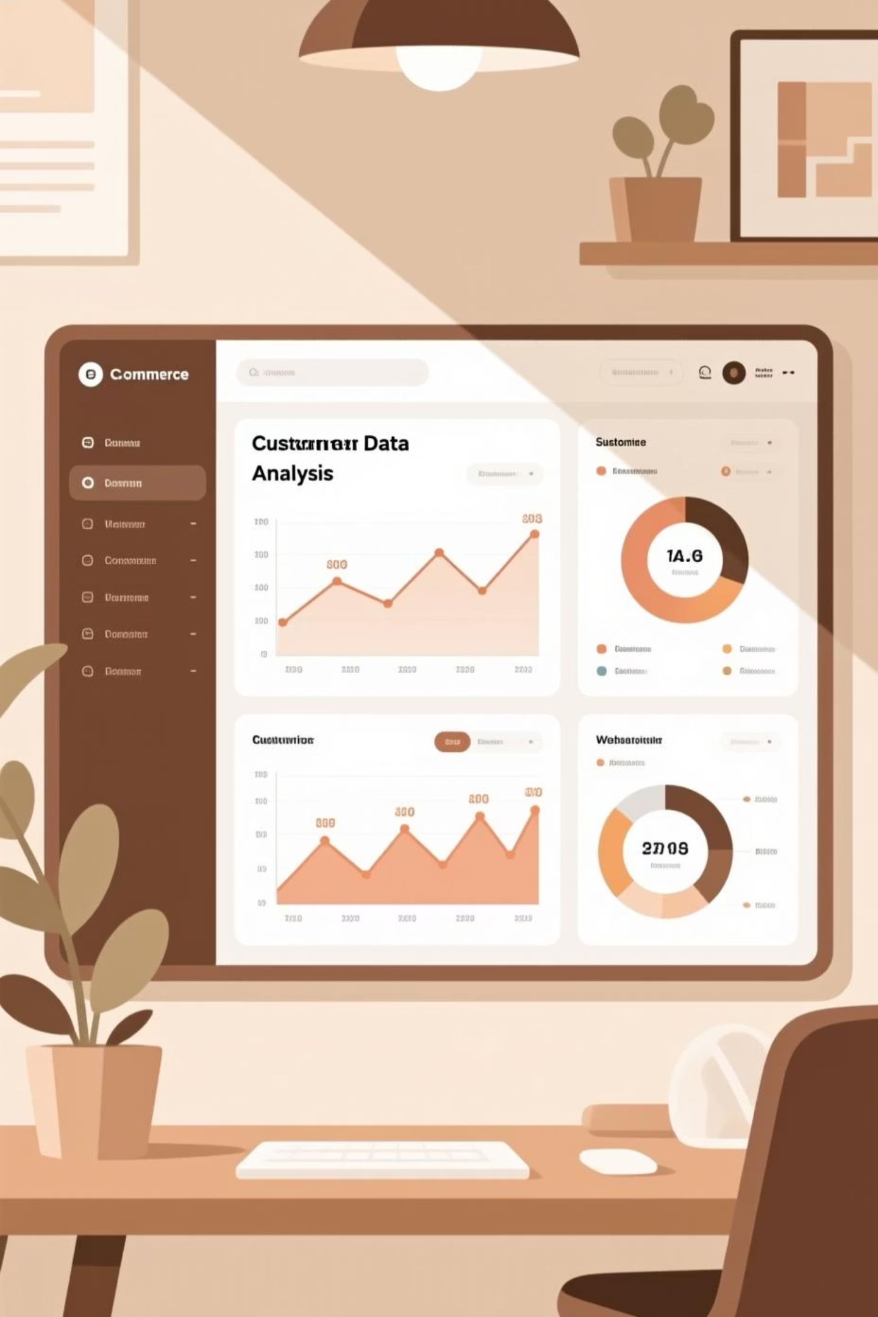
Customer Segmentation Using RFM Analysis in E-Commerce
By Dinesh Reddy

Slide 2

Problem Statement and Objective
E-commerce businesses struggle to convert vast transactional data into actionable insights for customer retention, churn reduction, and lifetime value optimization.
Identify High-Value Customers
Detect At-Risk Segments
Pinpoint customers at risk of churn before it happens
Discover top customers driving disproportionate revenue
Optimize Marketing ROI
Deploy targeted strategies based on behavioral patterns

Slide 3

Dataset Overview
Dataset Specifications
Key Variables
541,909 transactions across 8 variables
InvoiceNo & CustomerID
Timeframe: Dec 2010 – Sep 2011
Quantity, UnitPrice, InvoiceDate
Source: Kaggle E-commerce Dataset
Product Description & Country

Slide 4
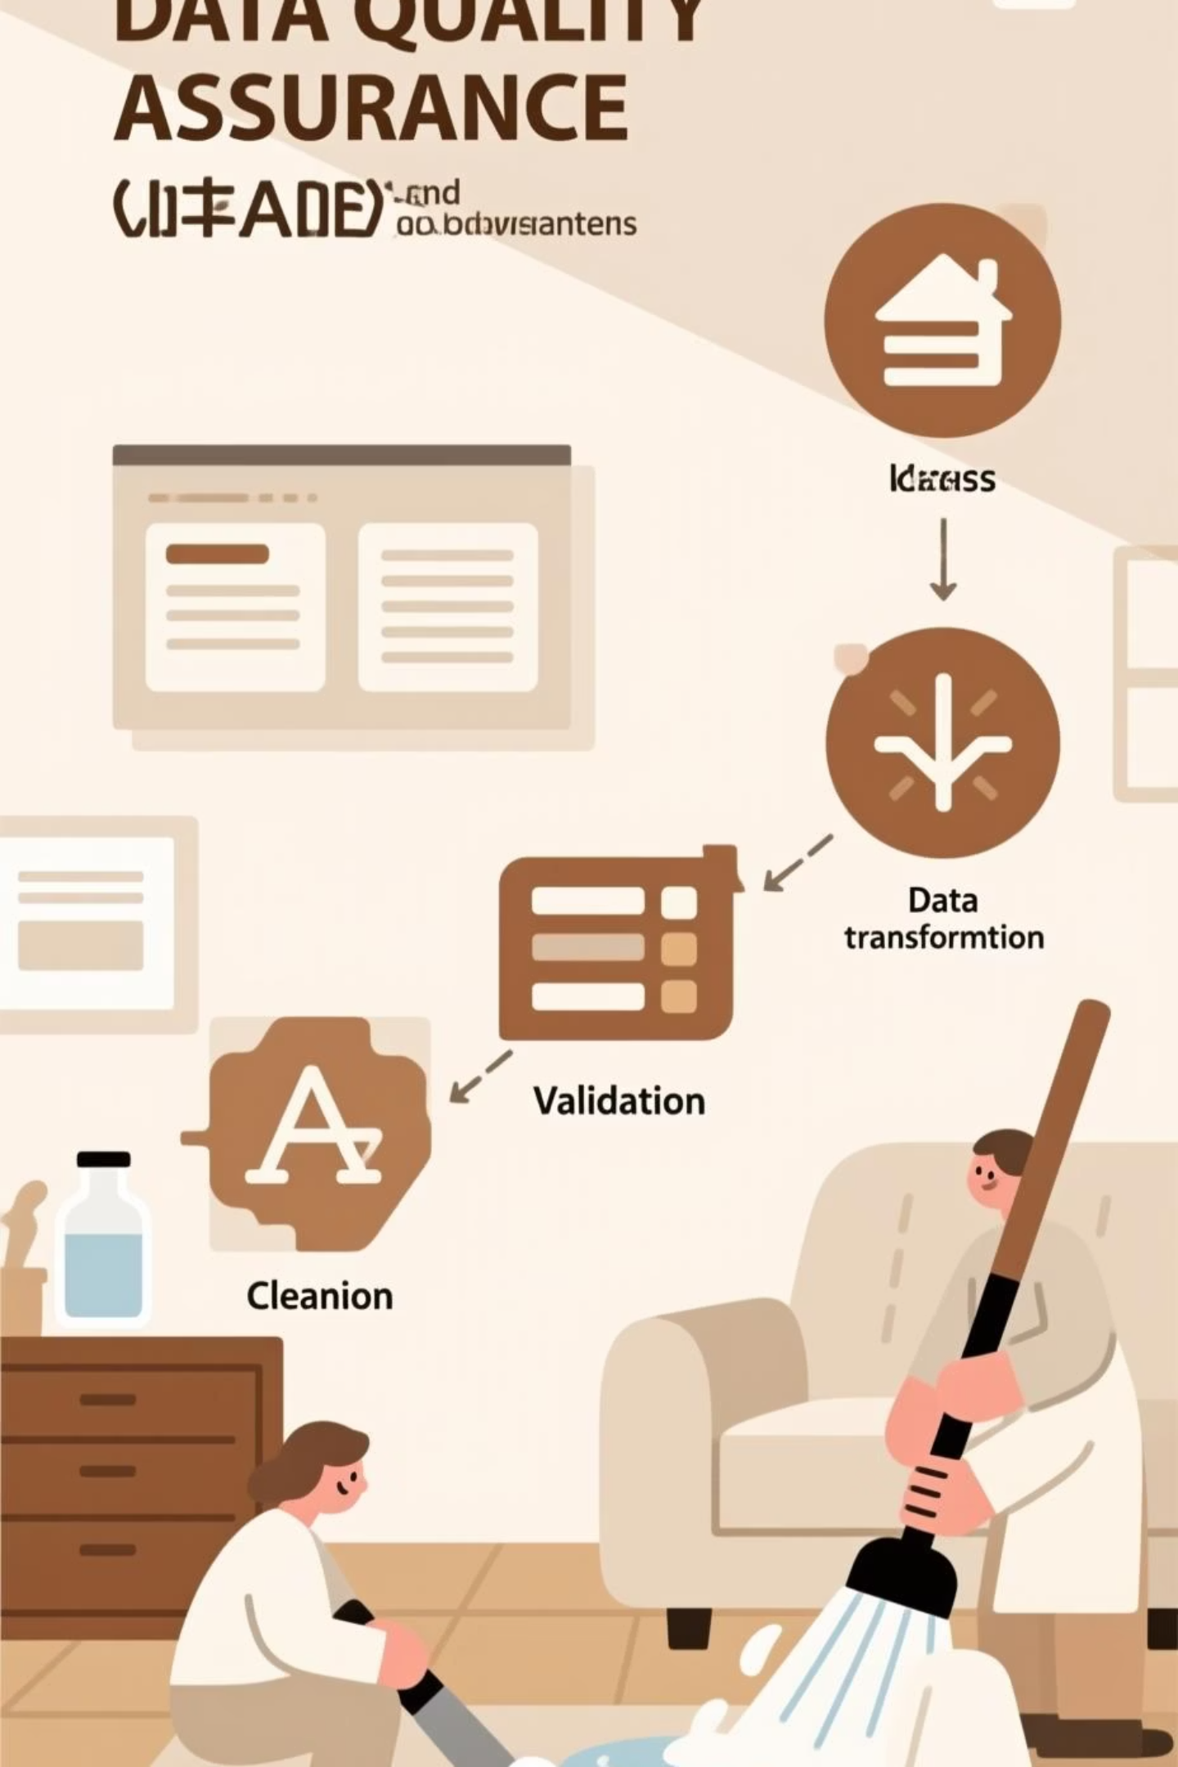
Data Cleaning Strategy
1
Missing Values
Identify and handle incomplete records
2
Duplicates
Remove exact duplicate transactions
3
Cancelled Orders
Eliminate negative quantity entries
4
Non-Product Codes
Filter out fees and postage entries

Slide 5
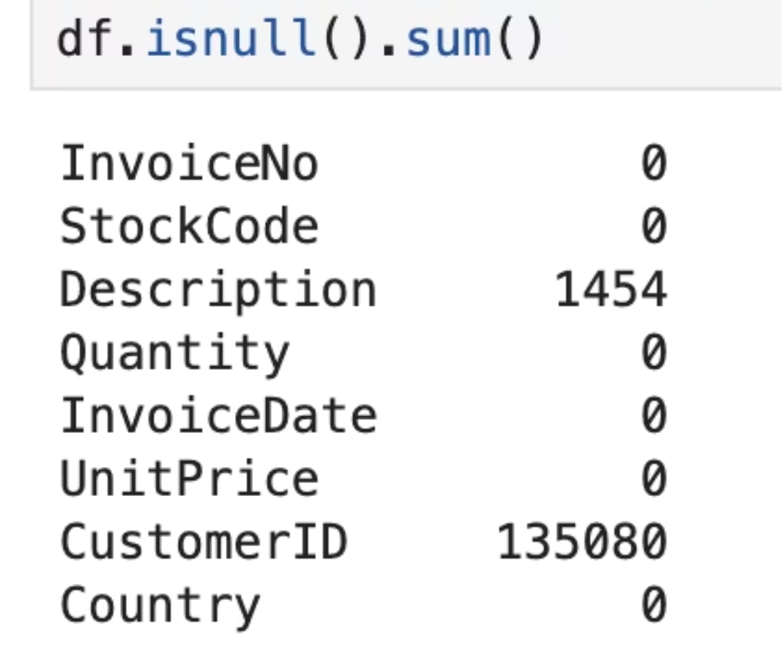
Missing CustomerID Data
24.93% of records missing CustomerID
Since RFM analysis requires customer-level tracking, all incomplete customer records were removed to maintain analytical integrity.

Slide 6
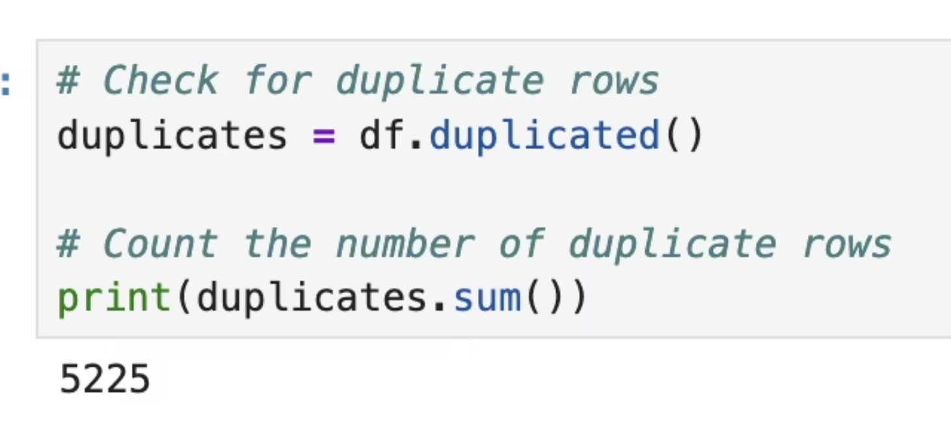
Duplicate Records Removal
5,525 duplicate rows identified and removed
Duplicates were exact replicas representing duplicate transaction entries, which would skew customer behavior metrics if retained.

Slide 7
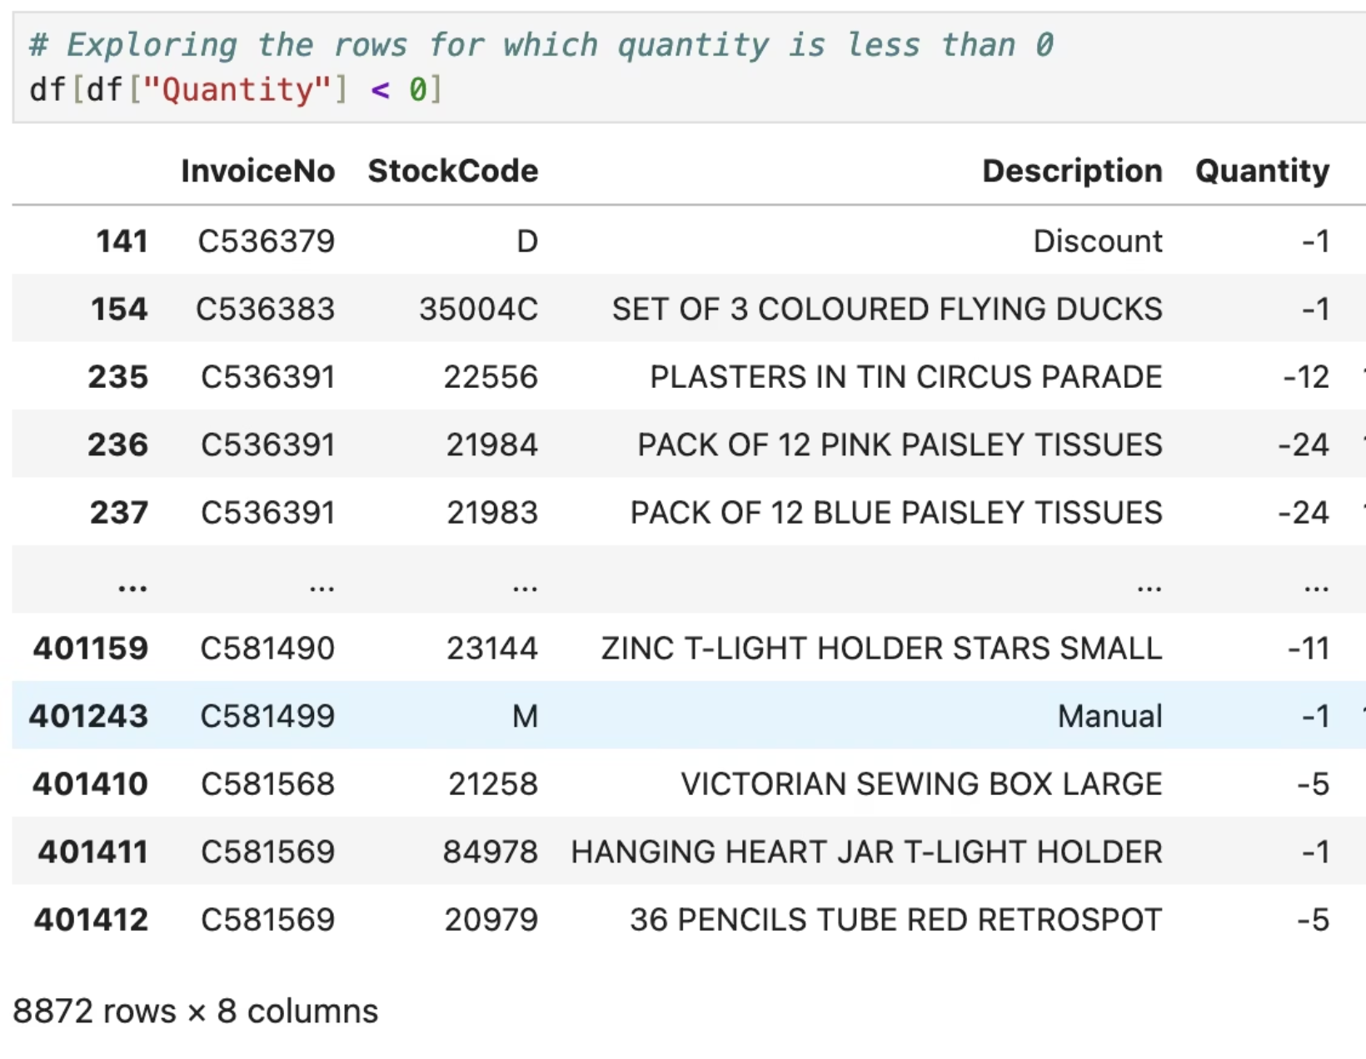
Cancelled Orders Elimination
8,872 cancelled transactions removed
Identified by negative quantities and invoice numbers starting with 'C'. These return orders distort customer value metrics and were excluded.

Slide 8
Non-Product Stock Codes Filtered
Stock Code
Description
POST
Postage charges
C2
Carriage fees
M
Manual adjustments
DOT
Dotcom postage
—
Bank charges
All non-product entries were removed to ensure RFM metrics reflect actual product purchasing behavior.

Slide 9
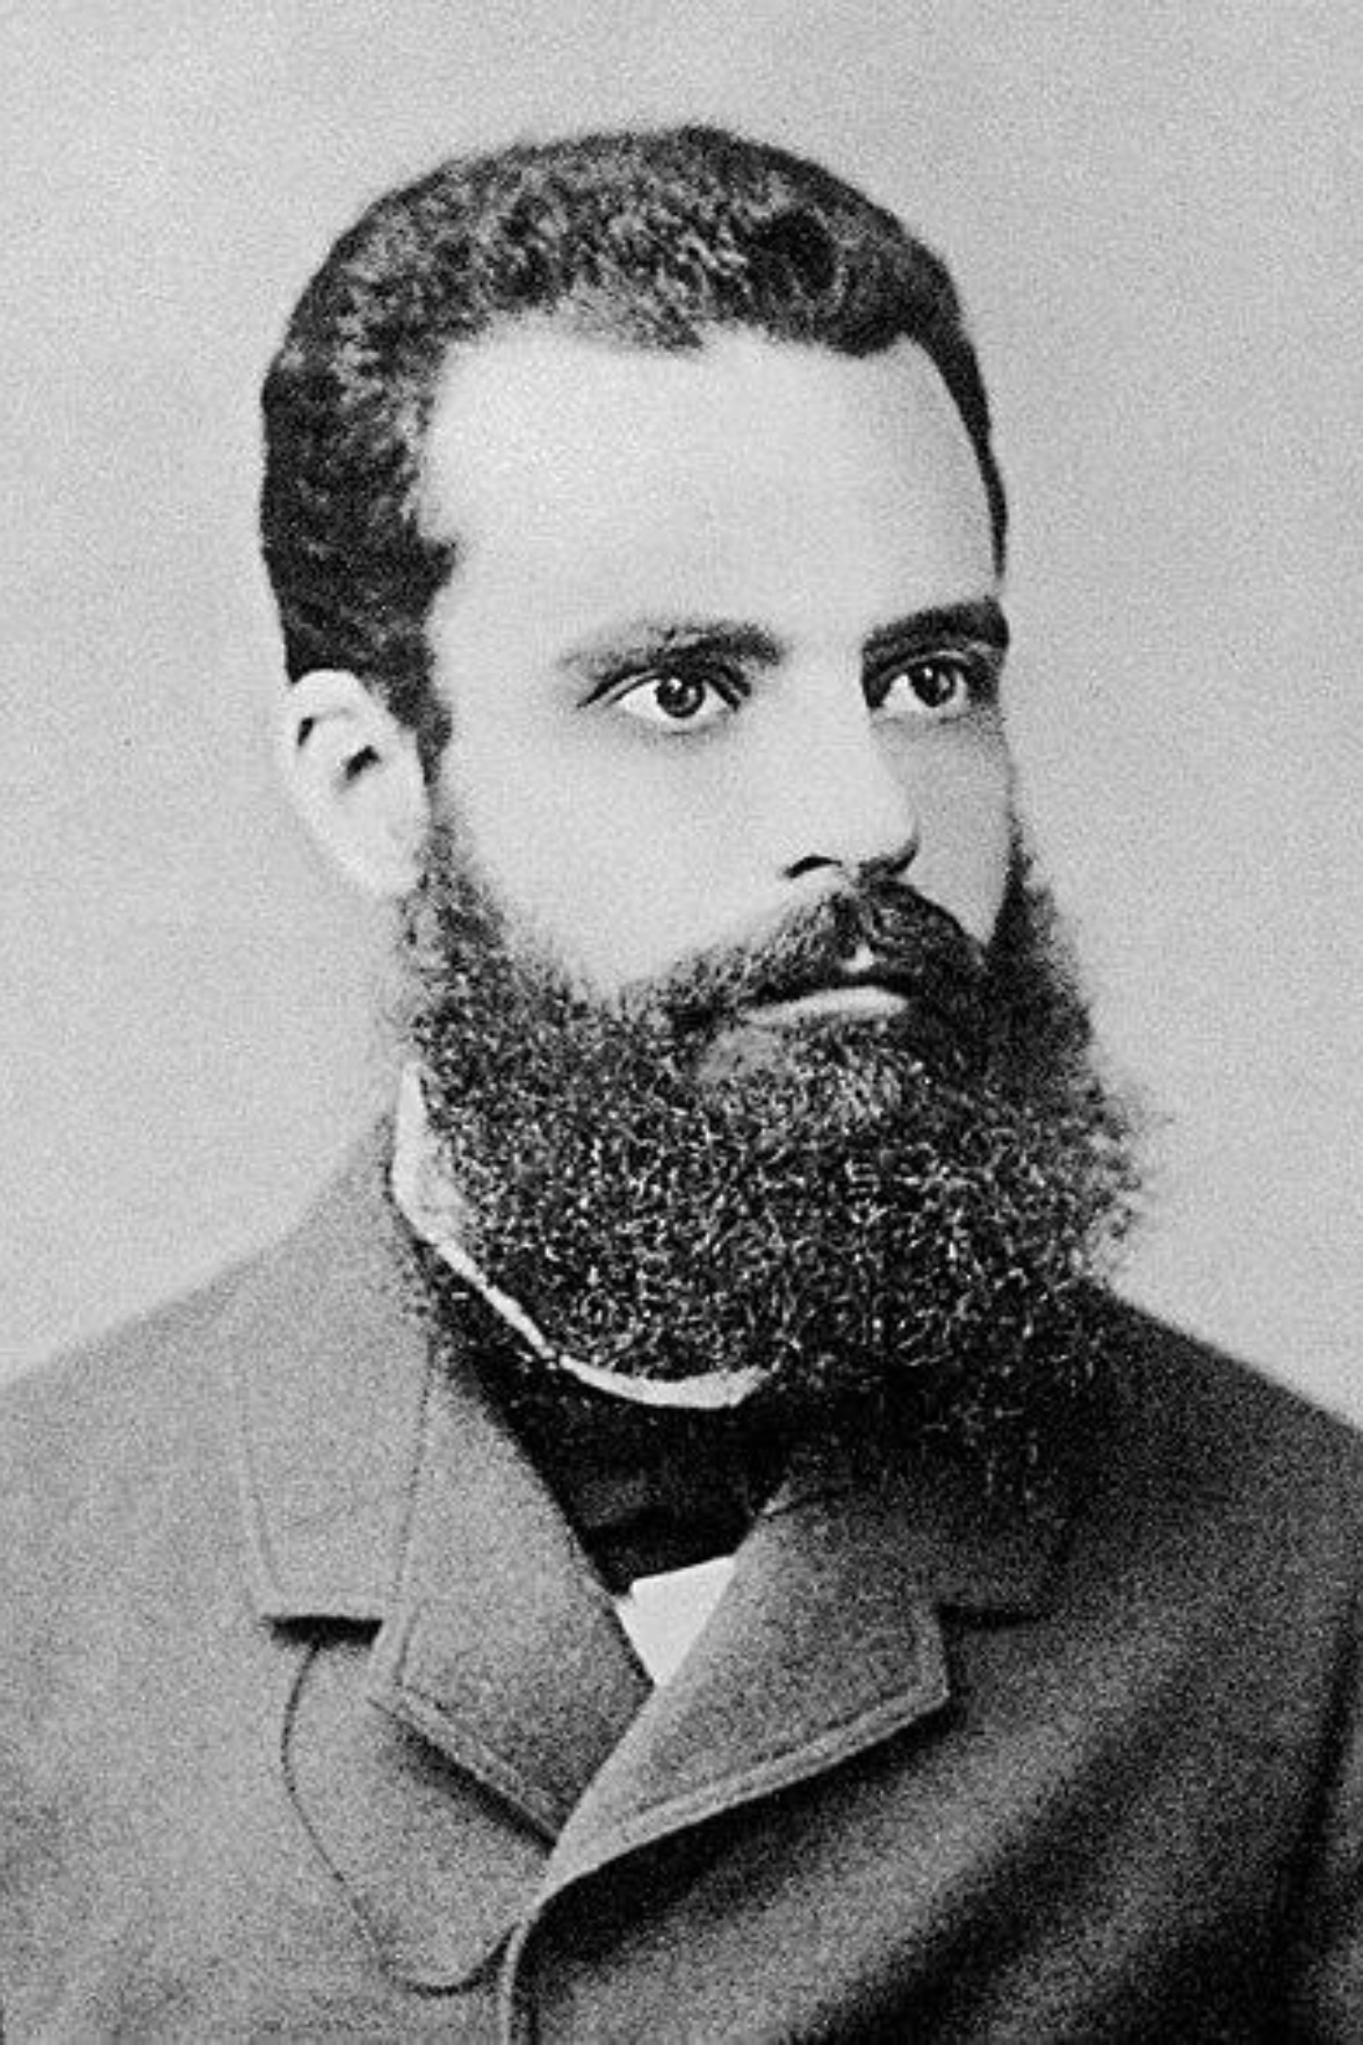
The Pareto Principle
80/20 Rule
Roughly 80% of outcomes stem from 20% of causes

Slide 10

Key Finding
26%
of customers drive 80% of revenue
This concentration underscores the critical importance of identifying and nurturing high-value customer segments through RFM analysis for maximum business impact.

Slide 11

21%
Products drive 80% of revenue
Understanding product contribution is critical for strategic resource allocation and inventory optimization in e-commerce operations.

Slide 12
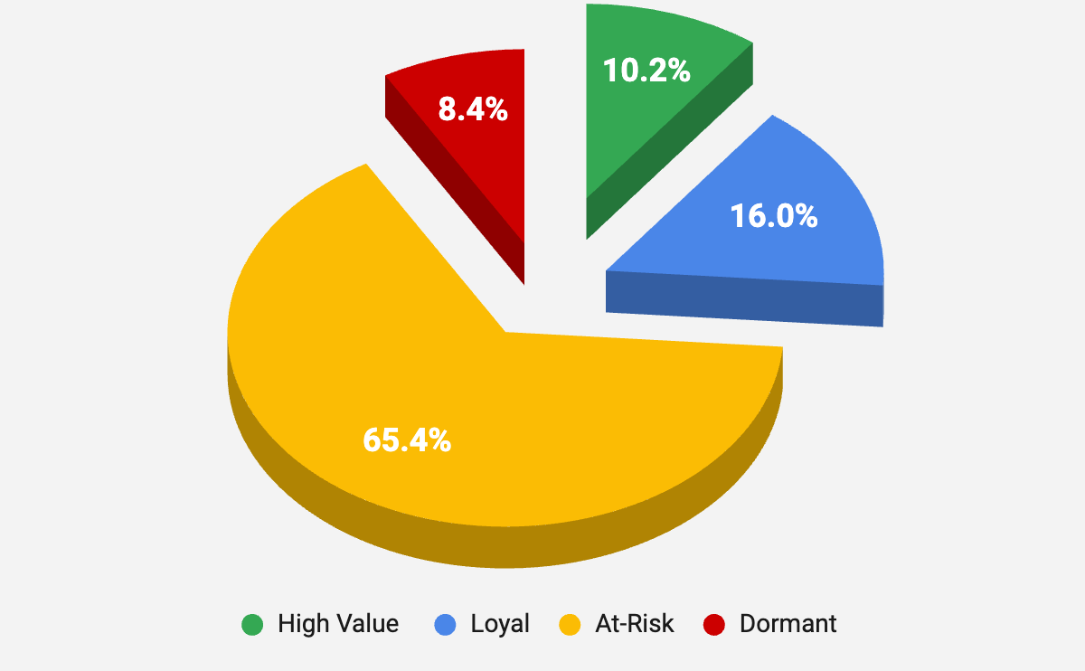



RFM Analysis Framework
Customer segmentation through Recency, Frequency, and Monetary metrics reveals actionable purchasing patterns.
Customer Segments Based on RFM Score
Recency
Frequency
Days since last purchase
Number of purchases
Monetary
Total spending value
Each customer receives a score from 1-5 for each metric, combined into an overall RFM score for segmentation and targeting.

Slide 13
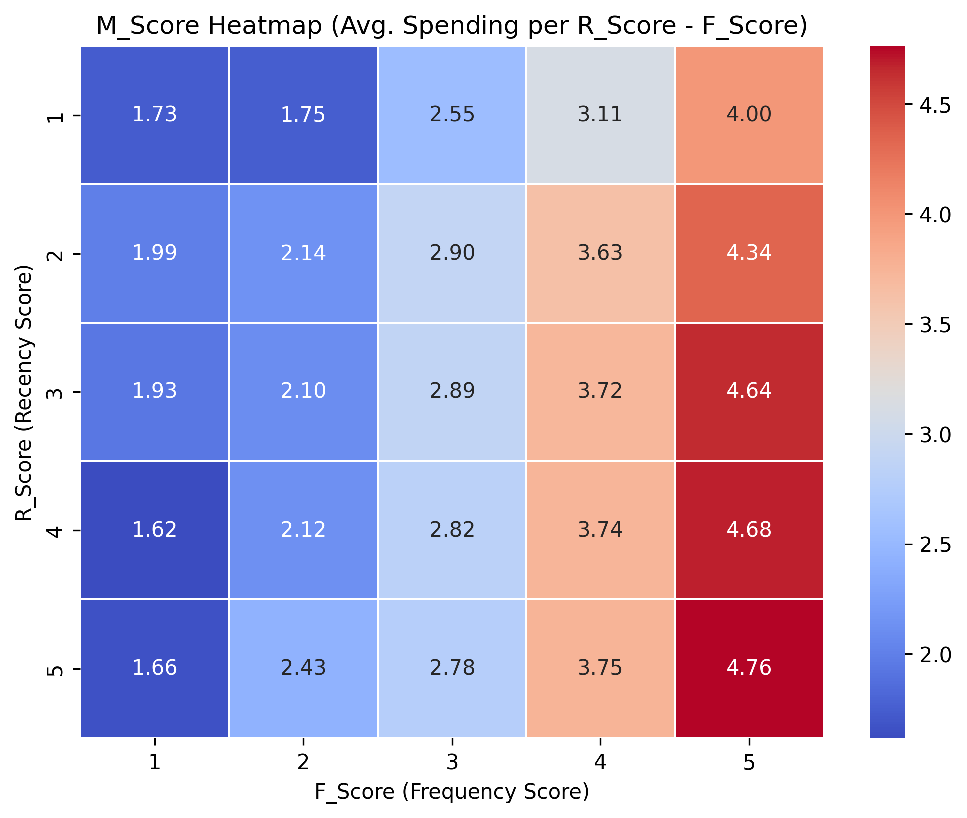
RFM Heat Map Analysis
Visual representation of customer value distribution across recency, frequency, and monetary dimensions.
Heat maps reveal concentration of high-value customers and identify optimization opportunities across segments.

Slide 14
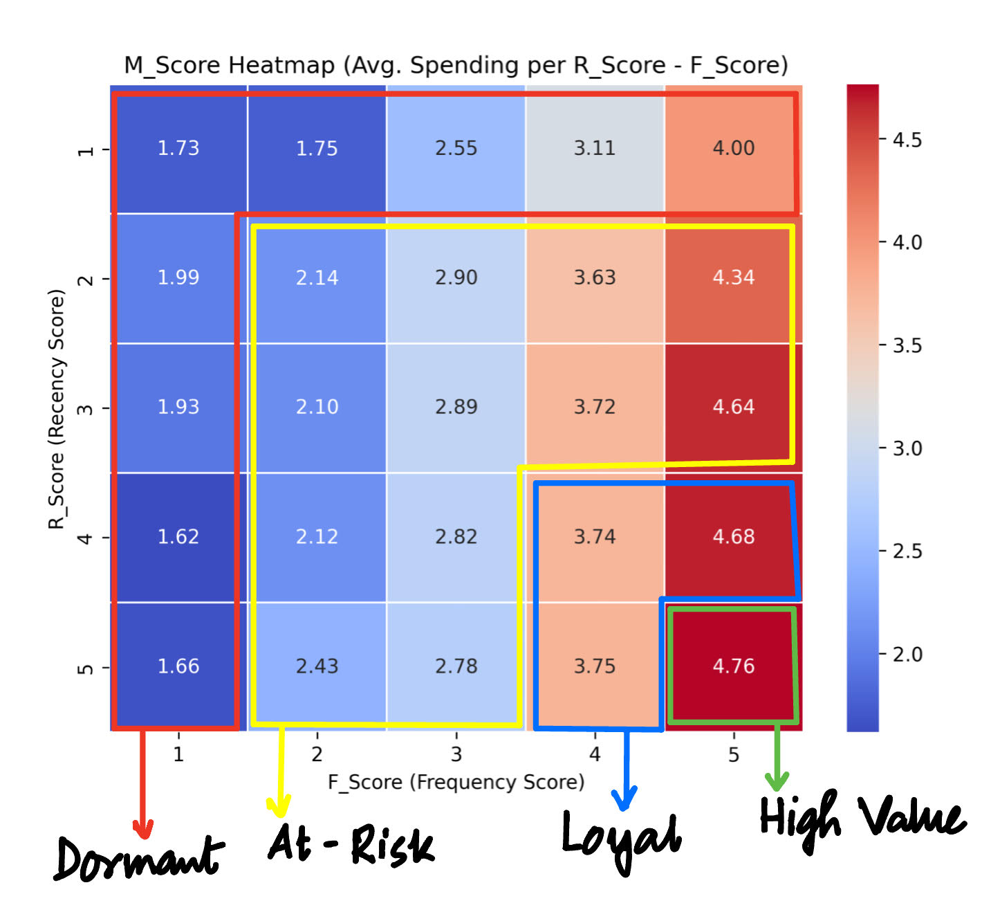
Four Customer Segments
RFM analysis identifies distinct customer archetypes requiring
tailored engagement strategies.
High Value
Brand advocates driving revenue growth
Loyal
Consistent performers with growth potential
At-Risk
Declining engagement patterns
Dormant
Requiring reactivation efforts

Slide 15
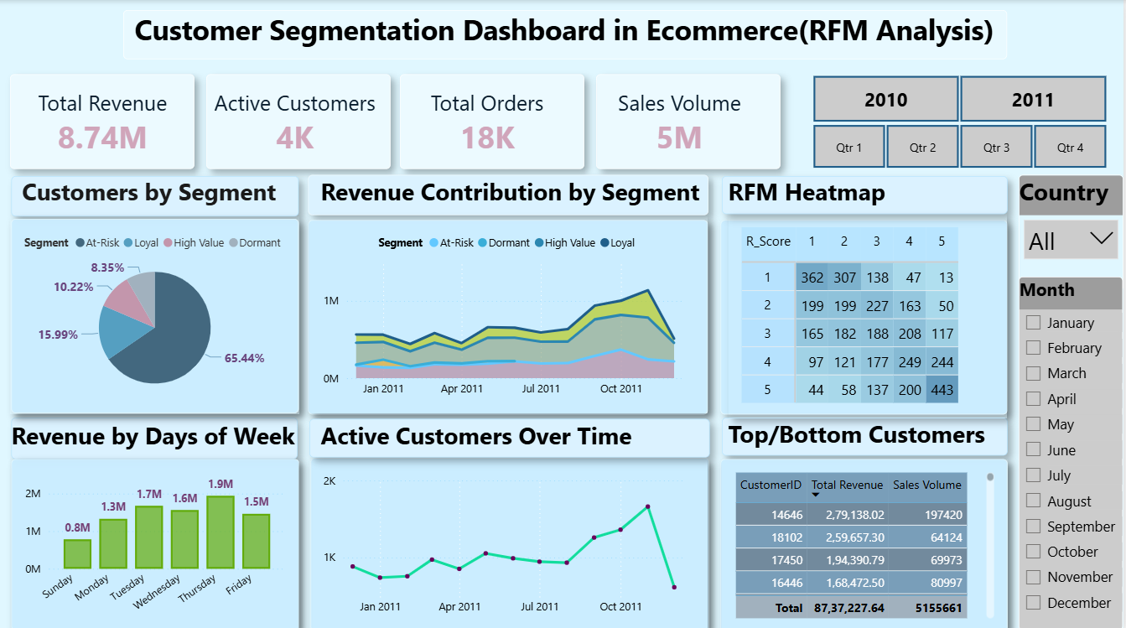
Customer Analytics Dashboard
Real-time monitoring of RFM metrics and segment performance enables data-driven decision-making.
Dashboards track segment transitions, lifetime value trends, and campaign performance metrics.

Slide 16

High Value Customers
Profile
Strategic Response
Characteristics: Brand advocates with exceptional engagement and spending patterns.
VIP loyalty programs with exclusive benefits
Early access to new products and sales
Behavior: Recent purchases, high frequency, elevated monetary value.
Personalized premium customer service
Referral incentive programs

Slide 17
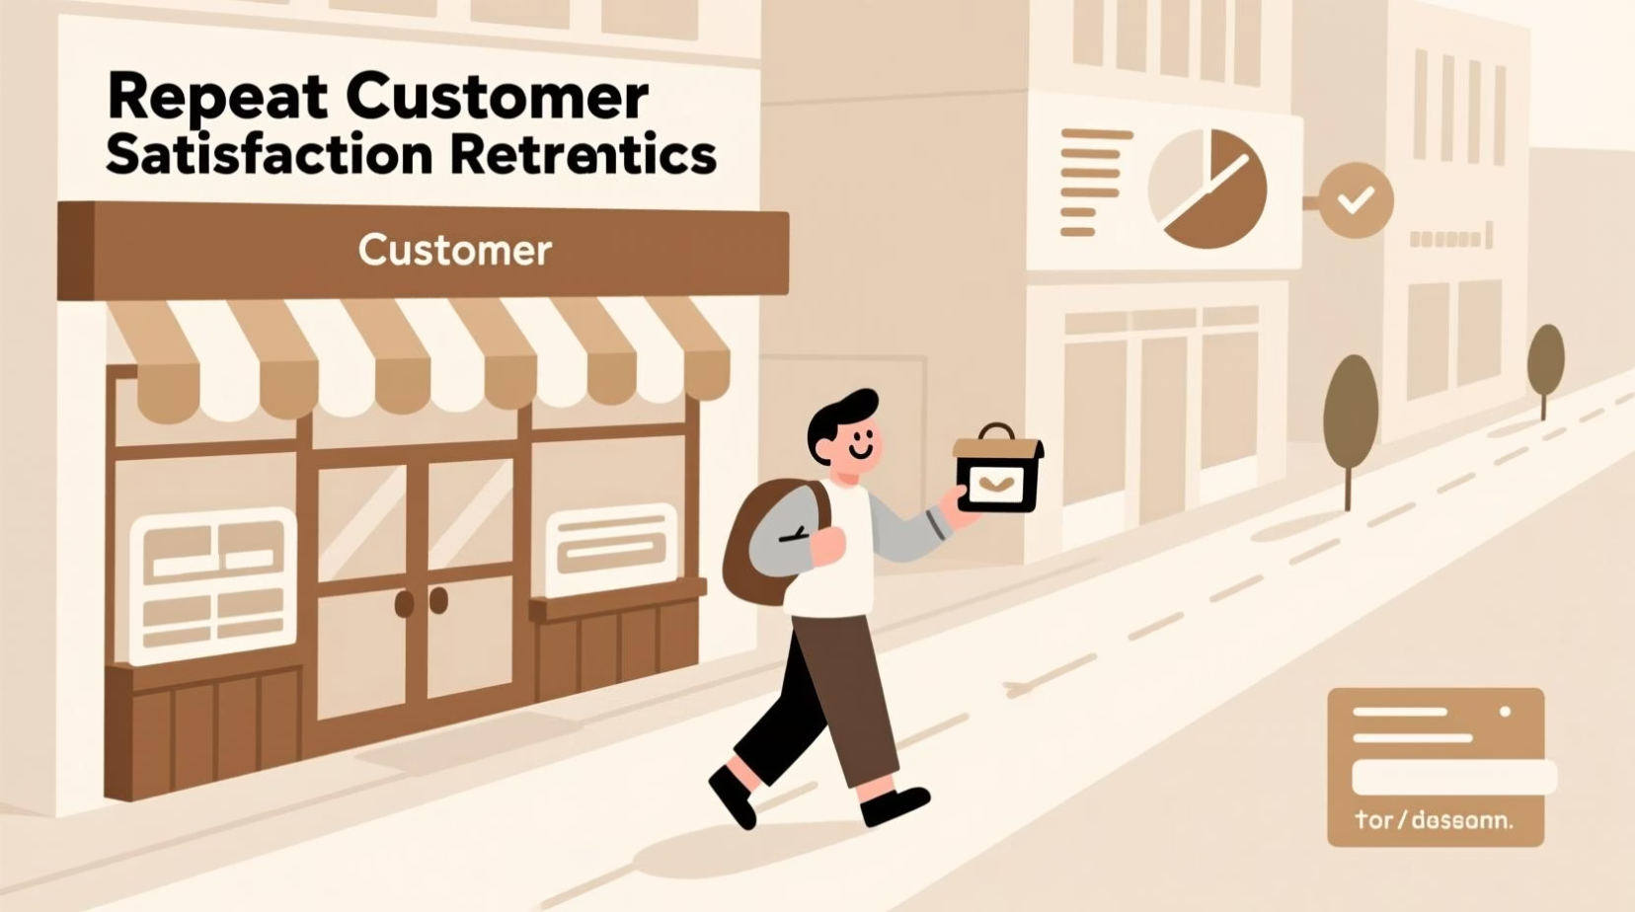
Loyal Customers
Profile
Strategic Response
Characteristics: Consistent buyers with moderate to high activity levels.
Cross-sell and upsell product recommendations
Tiered rewards program to increase basket size
Behavior: Average recency, moderately high frequency, substantial spending.
Seasonal promotions and bundle offers
Community building and engagement initiatives

Slide 18
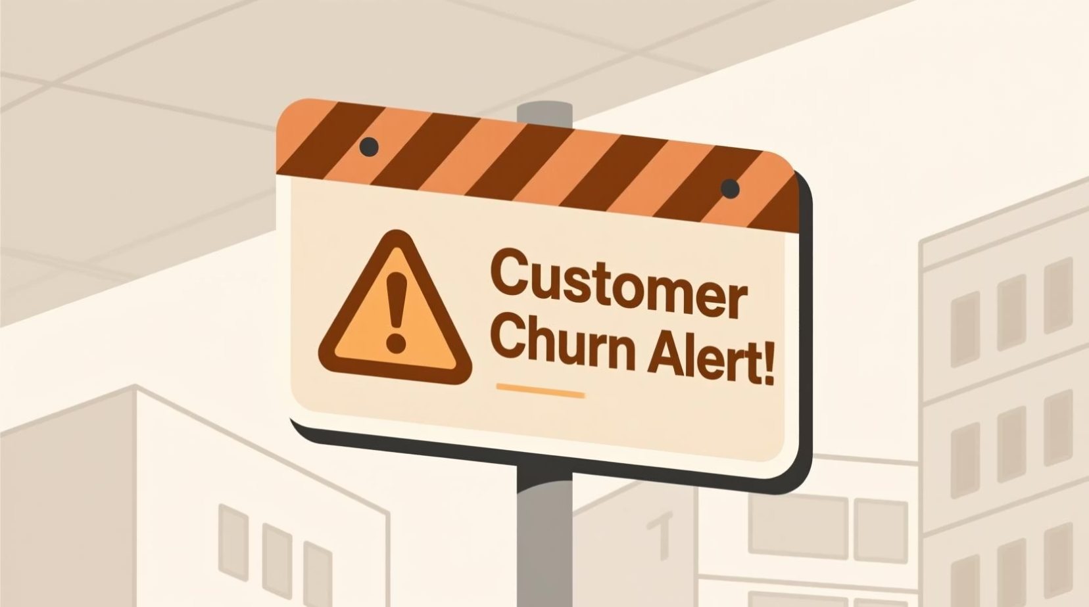
At-Risk Customers
Profile
Strategic Response
Characteristics: Inconsistent purchase behavior with declining engagement.
Targeted email campaigns with relevant offers
Limited-time promotions to trigger urgency
Behavior: Extended time since purchase, low frequency, variable spending.
Win-back incentives and exclusive discounts
Engagement survey to identify pain points

Slide 19

Dormant Customers
Profile
Strategic Response
Characteristics: Declining engagement with significant churn risk indicators.
Win-back email campaigns with strong value propositions
Satisfaction surveys to understand churn reasons
Behavior: Extended inactivity, minimal frequency, low or zero recent spending.
Aggressive discounts or exclusive comeback offers
Feedback collection for product or service improvements

Slide 20

Let's Connect
Dinesh Reddy
+91-9390057745
palakolanudineshreddy0403@gmail.com

